Slide 2
Cryptography & Public Key Infrastructure (PKI)

Slide 3
1. Cryptography & Public Key Infrastructure (PKI)
2.8 Summarize the basics of cryptographic concepts
3.9 Given a scenario, implement public key infrastructure
1.2 Given a scenario, analyze potential indicators to determine the type of attack

Slide 4
Explain cryptography algorithms and their basic characteristics
Hashing Algorithms
Salt, pepper, & Key Stretching algorithms
Symmetric Algorithms
Cipher Modes
Asymmetric Algorithms
Digital Signature
Block Chain
Public Ledger
Obfuscation
4
4

Slide 5
Summarize the Basics of Cryptographic Concepts
Encryption and decryption—encoding and decoding
Plaintext is the unencoded message; ciphertext is the coded message
Cipher is the means of change (the algorithm)
Cryptanalysis is the art of cracking cryptographic systems
Symmetric encryption terms
Initialization vector (starting value) - random starting value used as a secret key for data encryption
Nonce - arbitrary number that can be used just once
Confusion - cipher text significantly different than plaintext
Diffusion - small changes in plaintext result in large changes in ciphertext
Hashes (aka hash digests / digests)
A hash digest will NEVER change unless something in the cleartext changes
You cannot reverse a hash- hashes are one-way functions
The file size has nothing to do with the length of the hash. The length of the hash depends on the algorithm/key size
symmetric key = session key = private key

Slide 6
2.8 Summarize the basics of cryptographic concepts
Hashing
Hashing Algorithms
Algorithm | Type | Bit Sizes
MD5 | Hashing - Integrity | Creates 128-bit hashes
SHA-1 | Hashing - Integrity | Creates 160-bit hashes
SHA-2/SHA-3 | Hashing - Integrity | Creates 224-, 256-, 384-, or 512-bit hashes
HMAC-MD5 | Integrity/Authenticity | Creates 128-bit hashes
HMAC-SHA1 | Integrity/Authenticity | Creates 160-bit hashes
RIPEMD | Race Integrity Primitives Evaluation Message Digest (European) not widely used
HMAC (HMAC-MD5 and HMAC-SHA1)
Authentication header
Uses a shared secret to provide integrity/authenticity
IPsec and TLS use HMAC-MD5, HMAC-SHA1, and HMAC-SHA2

Slide 7



2.8 Summarize the basics of cryptographic concepts
Salting Passwords
Adds a random number to the password
Ensures that duplicate passwords are never stored
Prevents Hash Collisions
Makes it more difficult for brute-force attacks by increasing the key size
Dictionary Attacks
Rainbow Table Attacks (also known as cryptographic password attack)
Peppering Passwords
Peppers must be kept secret and cannot be stored with the hashed password
cat /etc/shadow | grep root
root:$1$CQoPK72h$370xDldmehakehg/ciatic.:14425:0:99999:7:::
User Password
Salt Added
Hashing Algorithm
Hashed Password + Salt
P@ssw0rd
P@ssw0rdyrtZd
5bc618ef0675036fd9a0c9a2daf2b872

Slide 8
2.8 Summarize the basics of cryptographic concepts
Key Stretching
The process of applying a salt and cryptographic hash to a password then repeating the process many times
Increase the computing time it takes to brute force a password using an offline attack
Increase the computation time required to crack a password
Increase the time needed to brute force a hashed password
Two key stretching methods include:
BCRYPT
Hashes password, then encrypts with Blowfish multiple times
PBKDF2 (Password-Based Key Derivation Function 2)
Key stretching method salts and hashes password values multiple times

Slide 9


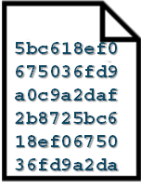
2.8 Summarize the basics of cryptographic concepts
Symmetric Encryption
The same key is used for both encryption and decryption
Encryption algorithms require one encryption key
Symmetric encryption is used to encrypt large amounts of data
Use block ciphers
Faster and more efficient than asymmetric encryption
Encapsulating Security Payload (ESP)
Symmetric Cipher with key size = Session Key
Session Key also known as secret key are
both symmetric keys
Same Key
Encryption
Decryption
Plain Text
Cipher Text
Plain Text

Slide 10
2.8 Summarize the basics of cryptographic concepts
Symmetric Encryption
Algorithm | Method | Key Size
AES | 128-bit block cipher | 128-, 192-, or 256-bit key
Twofish | 128-bit block cipher | 128-, 192-, or 256-bit key
Blowfish | 64-bit block cipher | 32- to 448-bit key
3DES | 64-bit block cipher | 56-, 112-, or 168-bit key
RC4 | Stream cipher | 40- to 2,048-bit key
DES | 64-bit block cipher | 56-bit key

Slide 11
2.8 Summarize the basics of cryptographic concepts
Two types of ciphers: Block ciphers and stream ciphers
Modes of Operation
ECB (Electronic Codebook)
Simplest (deprecated- Never Use). Encrypts each block with same key
CBC (Cipher Block Chaining )
Block cipher that uses initialization vector for randomization
Non-authenticated mode of operation
Block mode used with SSL 3.0 (or TLS 1.0) vulnerable to downgrade attacks (POODLE) that results in a MITM attack
(SSL 3.0/TLSv1.0 + CBC = MITM)
CTM - CCM - CTR (Counter)
Converts a block cipher into a stream cipher and provides authentication
GCM (Galois/Counter Mode)
Block cipher mode combines CTM with hashing techniques for integrity and provides authentication
Notes:
https://www.youtube.com/watch?v=Rk0NIQfEXBA

Slide 12
2.8 Summarize the basics of cryptographic concepts
Asymmetric Encryption
Encryption is accomplished with a pair of keys
A public key encrypts, the corresponding private key decrypts
Used in PKI and PGP
Different Key
Encryption
Decryption
Plain Text
Cipher Text
Plain Text

Slide 13
2.8 Summarize the basics of cryptographic concepts
Asymmetric Encryption
RSA (Rivest - Shamir - Adleman)
Widely used to protect Internet traffic and email
Start at 1,024, 2,046, 3,072, and 4,096 bits
Used for encryption and digital signatures
Commonly used with asymmetric encryption to privately share a symmetric key
Digital Signature Algorithm (DSA)
Used for digital signatures
Start at 512 bits
1,024-bit and 2,046-bit keys are faster than RSA for digital signatures

Slide 14
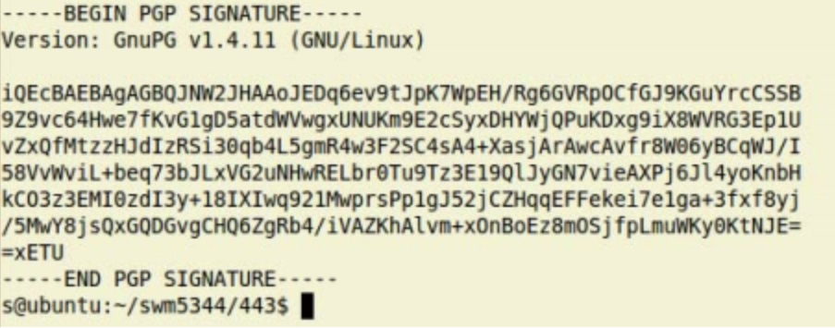


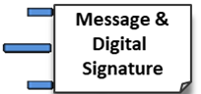
2.8 Summarize the basics of cryptographic concepts
Digital Signatures – use public key cryptography
Provides Authentication – identifies the sender
Non-repudiation – prevents the sender from denying the action
Integrity – verifies the message has not been modified
Sender used private key (RSA) to encrypt
Recipient must use senders public key (RSA) to decrypt
Hash of message encrypted with sender’s private key
StackOverflow.com
Sender's private key (certificate) encrypts
Senders Public key (certificate) decrypts
Sender
Recipient
Encrypted hash decrypted with sender’s public key

Slide 15
2.8 Summarize the basics of cryptographic concepts
Asymmetric Encryption
ECC (Elliptic Curve Cryptography)
Algorithm family that was developed for use cases in which power consumption and lower computing power are constraints
Commonly used with small wireless devices
Symmetric algorithm is normally DES/3DES except for military devices which always use AES.

Slide 16
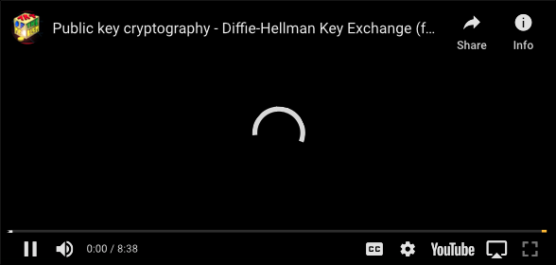
Diffie Hellman
Notes:
https://www.youtube.com/watch?v=YEBfamv-_do&list=PLA7bpMWMDc1Fbw1xH9hs8PgI_brfplHjs&index=2&t=35s

Slide 17
2.8 Summarize the basics of cryptographic concepts
Asymmetric Encryption
Diffie-Hellman (DH)
Asymmetric technique that protects symmetric keys by setting up a secure channel
Secure method of sharing symmetric keys over a public network
Creates the keys used in the Internet Key Exchange (IKE)
IKE Uses UDP port 500 to set up the secure session
Diffie-Hellman Ephemeral (DHE)
Elliptic Curve Diffie-Hellman Ephemeral (ECDHE)
TLS_ECDHE_RSA_WITH_AES_256_GCM_SHA384
TLS_DHE_RSA_WITH_AES_256_GCM_SHA384

Slide 18
2.8 Summarize the basics of cryptographic concepts
Asymmetric Encryption
Ephemeral Keys
Asymmetric function that generates a new and separate key every time it runs
Short-lived keys
Used for a single session
Used to support Perfect Forward Secrecy (PFS)
Perfect Forward Secrecy
Preventing cryptographic reuse so a compromise of one operation does not affect other operations
DHE (Diffie-Hellman Ephemeral)
ECDHE (Elliptic Curve Diffie-Hellman Ephemeral)

Slide 19
2.8 Summarize the basics of cryptographic concepts
Asymmetric Encryption
Secure/Multipurpose Internet Mail Extensions (S/MIME)
Used for digital signature between two people
Encrypt and sign email using S/MIME
Supports the strategy and employs certificates generated by the PKI
Implements a stream cipher
Pretty Good Privacy (PGP)
Used between two users to set up an asymmetric encryption and digital signatures
First stage in using PGP is to exchange the keys
Uses RSA keys

Slide 20
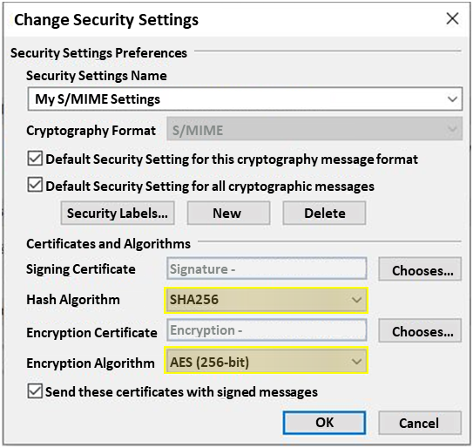
2.8 Summarize the basics of cryptographic concepts
Email Encryption
Encrypting email provides confidentiality
Email encrypted with symmetric key
Symmetric Key encrypted with recipient’s public key
Recipient used private key to decrypt
Recipient's Public key encrypts
Recipient's Private key decrypts
Asymmetric Encryption: Symmetric Key encrypted with recipient’s public key (RSA)
Symmetric Encryption: Email encrypted with symmetric key (AES_256GCM_SHA256)
Sender
Recipient

Slide 21
2.8 Summarize the basics of cryptographic concepts
Blockchain
A blockchain is a form of public ledger, which is a series (or chain) of blocks on which transaction details are recorded.
Data is stored in batches called blocks that are distributed to many computers
Data entered is irreversible.
Transactions are permanently recorded and viewable to anyone.
If you wanted to tamper with the blockchain, it would have to change the data on every computer holding a copy

Slide 22
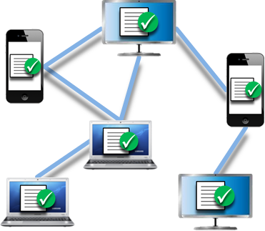


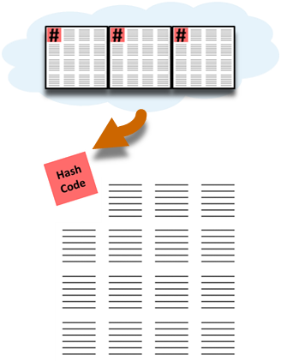
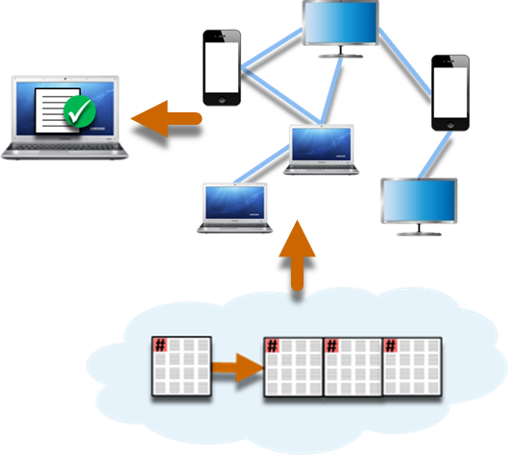
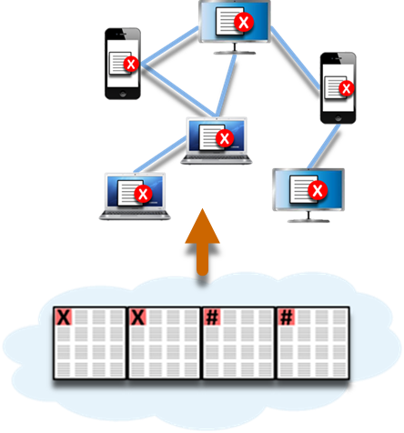
Blockchain
A Transaction is requested. The transaction could be any digital transaction from Bitcoin, Voting, medical records, data backups.
The transaction is sent to every computer, or node, in a decentralized network to be verified.
The verified transaction is added to a new block of data containing other recently verified transactions.
A secure code, called a Hash, is calculated from the previous blocks of transaction data in the blockchain. The has is added to the new block of verified transactions.
The block is added to the end of the Blockchain which is then updated to all nodes in the network for security. The transaction is complete.
If any blocks are altered, its hashes in the chain are automatically recalculated. The altered chain will no longer match the chains stored by the rest of the network and will be rejected.
23

Slide 23
2.8 Summarize the basics of cryptographic concepts
Public Ledger
A cryptocurrency public ledger is a record-keeping system
The ledger maintains participants’
Identities are anonymous
Keeps respective cryptocurrency balances
Keeps record of all the genuine transactions executed between network participants
The most important difference to remember is that blockchain is just one type of distributed ledger
Blockchain is a sequence of blocks
Distributed ledgers do not require such a chain

Slide 24
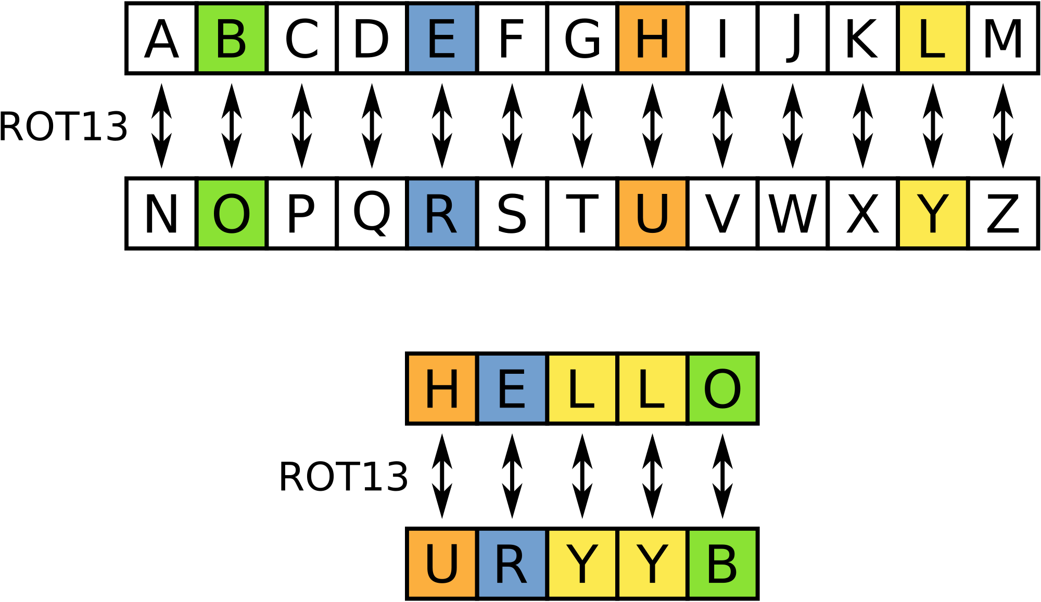
Explain cryptography algorithms and their basic characteristics
Obfuscation
How to achieve security through obscurity?
Substitution Cipher
Replaces plaintext with ciphertext using a fixed system
ROT13 (Rotate 13 Places)
Substitution cipher that rotates a letter 13 places
Steganography
Concealing data within data
Often uses files that can be manipulated without introducing new artifacts, such as images, audio, or video files
Covert channels
OTP – One-Time Pad
The only truly unbreakable code!
24
24
Notes:
https://www.cryptomuseum.com/crypto/otp/index.htm

Slide 25
2.8 Summarize the basics of cryptographic concepts
Obfuscation
XOR (Exclusive OR)
Logical operation comparing two inputs
01010111 | 01101001 | 01101011 | 01101001 | Plaintext
11110011 | 11110011 | 11110011 | 11110011 | Key
10100100 | 10011010 | 10011000 | 10011010 | Ciphertext
10100100 | 10011010 | 10011000 | 10011010 | Ciphertext
11110011 | 11110011 | 11110011 | 11110011 | Key
01010111 | 01101001 | 01101011 | 01101001 | Plaintext

Slide 26
Answer the Questions…
A manufacturing company would like to track the progress of parts as they are used on an assembly line. Which of the following technologies would be the BEST choice for this task?
Quantum computing
Blockchain
Transport Layer Security
Perfect forward secrecy
After a ransomware attack, a forensics company needs to review a cryptocurrency transaction between the victim and the attacker. Which of the following will the company MOST likely review to trace this transaction?
The public ledger
The NetFlow data
A checksum
The event log
Notes:
Answers
b (blockchain)
2. a (the public ledger) The public ledger is used as a record-keeping system that maintains participants' identities in secure and (pseudo-)anonymous form, their respective cryptocurrency balances, and a record book of all the genuine transactions executed between network participants. Event log records can be used to describe an event within a smart contract, like a token transfer or a change of ownership. The public ledger used to be completely anonymous, but this is no longer so, which is why it is the better answer in this scenario.

Slide 27

QUESTIONS

Slide 28
NEXT TOPIC….
PKI Components
PKI Concepts
Types of Certificates
Certificate Formats

Slide 29


Given a scenario, implement public key infrastructure
CA
S
CR
R
P
P
Sender
Recipient
t
CSR
CSR
t
29
29

Slide 30

Given a scenario, implement public key infrastructure
Sender
P
R
t
____________________________________________
____________________________________________
____________________________________________
D. S.
ABC123
D. S.
30
30

Slide 31
Given a scenario, implement public key infrastructure
S
P
Recipient
t
____________________________________________
____________________________________________
D. S.
?
ABC123
ABC123
31
31

Slide 32
CA
S
CR
S
R
P
P
R
Sender
Recipient
t
t
____________________________________________
____________________________________________
____________________________________________
____________________________________________
D. S.
D. S.
ABC123
ABC123
?
ABC123
D. S.

Slide 33






3.9 Given a scenario, implement public key infrastructure
A certificate allows us to verify someone’s identity and their public key, but how do we know it’s valid?
Certificate Revocation List (CRL)
CRLs are downloaded with a (fixed) interval, once downloaded, the certificate in question will be locally evaluated if it’s revoked
Checks whether a certificate is valid
Updates must be frequently downloaded to keep the list current
No matter the scenario, is to check the CRL unless replaced by OCSP
Checks the validity of certificates even when internet access is unavailable
CA Server
Database with all revoked certificates
CA
Client contacts the CA’s certificate server and downloads the certificate revocation list
CRL
Server sends its SSL/TLS certificate to the client
Client
Server
Client Seeks to connect to a website

Slide 34
3.9 Given a scenario, implement public key infrastructure
Public key infrastructure (PKI)
Online Certificate Status Protocol (OCSP)
OSCP works with a request-response mechanism requesting the most accurate information the CA can provide at that moment
Perform real-time validation of SSL certificates
Is used only when the CRL is going slow or has been replaced by the OCSP
Certificate validity can only be done by the CRL or OCSP

Slide 35

3.9 Given a scenario, implement public key infrastructure
Online Certificate Status Protocol (OCSP)
Using the certificates serial number, the OCSP responder checks the status in real time and sends a response back to the client providing faster and more accurate results.
Good
Revoked
Unknown
CRL
OCSP Server
CA Server
Database with all revoked certificates
CA
The client sends an OCSP request to OCSP Server to check the status of the certificate’s
Server sends its SSL/TLS certificate to the client
Client
Server
Client Seeks to connect to a website

Slide 36



3.9 Given a scenario, implement public key infrastructure
Public key infrastructure (PKI)
OCSP Stapling
Mitigates attacks using revoked certificates for MITM attacks to steal credentials
Client connects to site and performs SSL/TLS handshake
Client
Signed
Certificate
Web server sends back signed certificate with “stapled” OCSP response
Web Server
Web Server queries OCSP server at regular intervals save signed result in a cache
OCSP Server cryptographically signs and time-stamps an OCSP response
OCSP Server

Slide 37
3.9 Given a scenario, implement public key infrastructure
Public key infrastructure (PKI)
Certificate pinning
Public keys are “pinned” to a client’s system
Certificate pinning makes sure the client verifies the server’s certificate against a known copy of the certificate (Pinned Certificate)
From then on, the client will compare their pinned key with the key presented in the resource’s certificate
If the certificate does not match the connection will be dropped
Prevents the compromising of the CA
Prevents Certificate spoofing (fraud)
Prevents SSL man-in-the-middle attacks
Mitigates impersonation attempts
Pinned Certificate
SSL certificate
Client
Server

Slide 38
3.9 Given a scenario, implement public key infrastructure
Public key infrastructure (PKI)
Root Certificate Authority (CA)
A trust anchor in a PKI environment is the root certificate from which the whole chain of trust is derived
Issues certificates to intermediate Cas
Online CA
An internal online CA is always up and running
Users can request a certificate at any time of the day or night
Would not be the case in a government or top-security environment
Offline CA
Environment where clearance and vetting must be completed before someone can be issued with a certificate
CA is kept offline and locked up when it is not being used
Switched off so that it cannot issue new certificates

Slide 39
3.9 Given a scenario, implement public key infrastructure
Public CA (Also known as a third-party CA )
Commercially accepted as an authority for issuing public certificates
Registration Authority (RA)
Accepts requests for digital certificates and authenticates the entities making those requests.
Intermediary Certificate Authority
Issues the X.509 certificates
Key Escrow
Private keys is found in a key escrow
Holds the private keys for third parties and stores them in a Hardware Security Module (HSM)

Slide 40
3.9 Given a scenario, implement public key infrastructure
Public key infrastructure (PKI)
Trust model
A trust model proves the authenticity of a certificate; there are two trust models:
Hierarchical trust model
Uses a hierarchy from the root CA down to the intermediary
Bridge trust model
Two separate PKI environments trust each other

Slide 41
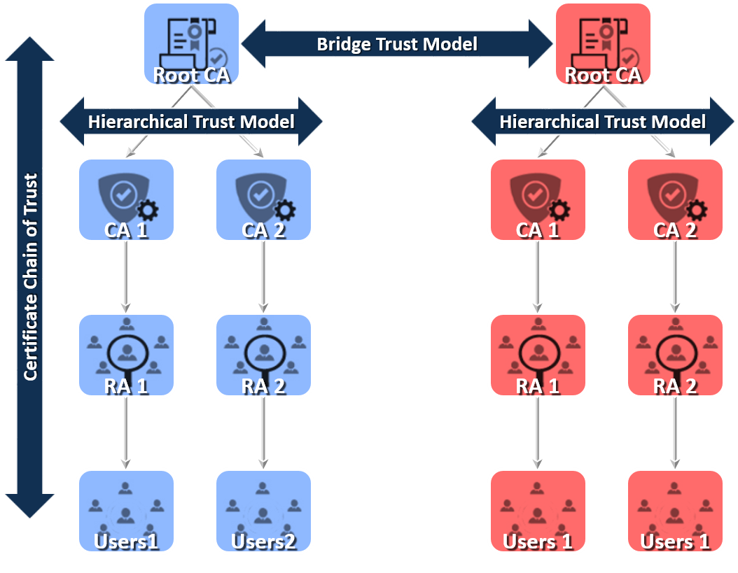
Certificate Authorities and Trust Models
Hierarchical/Bridge chain of trust
A trust model proves the authenticity of a certificate; there are two trust models:
Hierarchical trust model
Uses a hierarchy from the root CA down to the intermediary
Bridge trust model
Two separate PKI environments trust each other
What Certificate Authorities Do…
Ensure validity of certificates and users
Establish trustworthy working procedures
Manage servers and keys

Slide 42
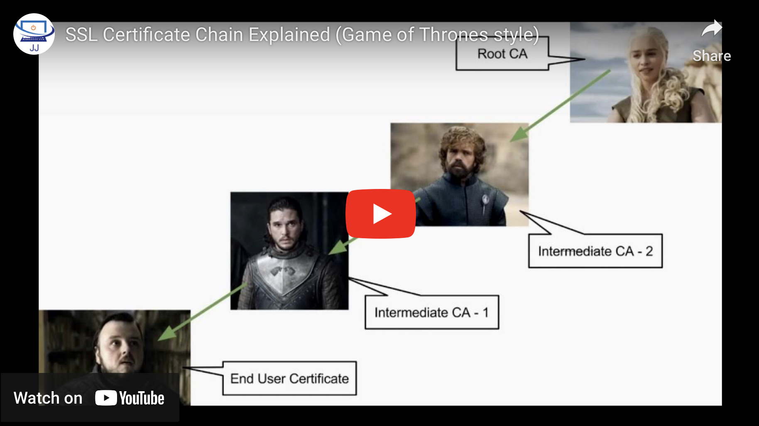
SSL Certificate Chain Explained (Game of Thrones style)
Notes:
https://www.youtube.com/watch?v=msBrdFiSvW4

Slide 43
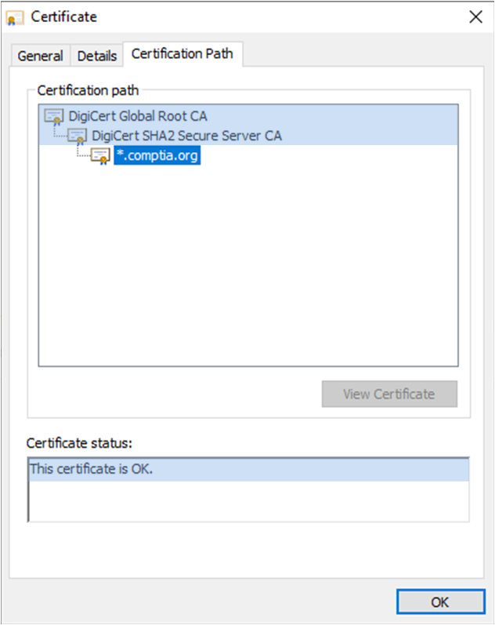
3.9 Given a scenario, implement public key infrastructure
Certification Path
Certificate Chain of Trust
Root CA
DigiCert Global Root CA
Intermediary CA (Issuing CA or Issuer)
DigiCert SHA2 Secure Server CA
End Entity (User)
*comptia.org
No trust error

Slide 44
3.9 Given a scenario, implement public key infrastructure
Public key infrastructure (PKI)
Certificate signing request (CSR)
Process of requesting a new certificate
Two keys are generated, and the public is sent to the CA
Create the RSA-based public key, which is used to create the private key
Include the public key in the CSR
The CA will embed the public key in the certificate

Slide 45
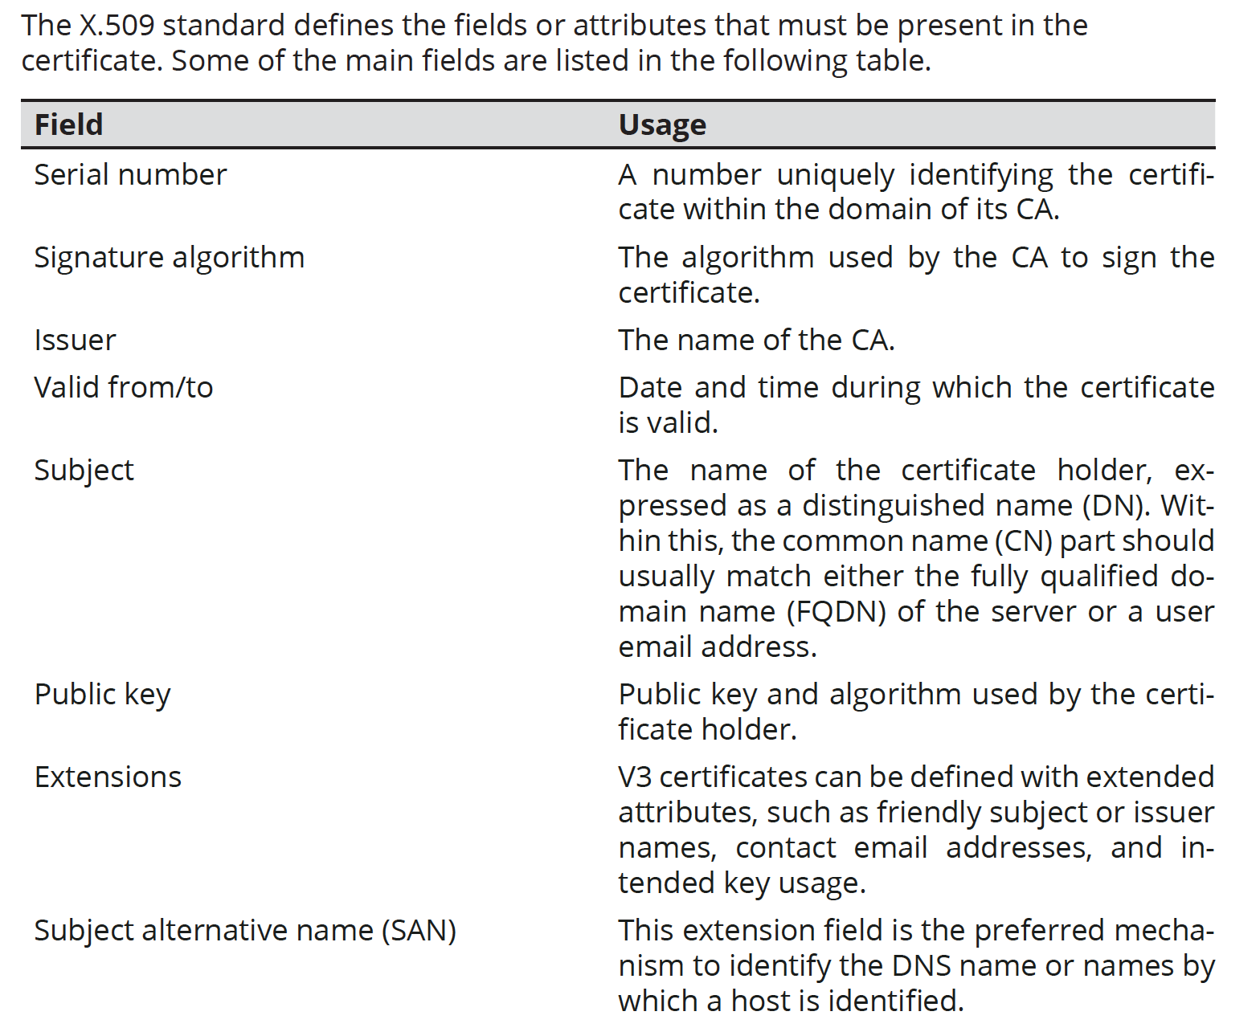
3.9 Given a scenario, implement public key infrastructure
Certificate Attributes

Slide 46
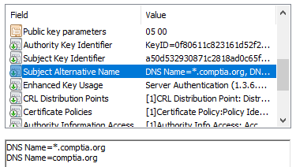
3.9 Given a scenario, implement public key infrastructure
Common Name (CN)
Legacy method of recording FQDN
Deprecated by standards, BUT still used in many implementations
the characteristic value within a Distinguished Name (DN)
Multi-Domain Wildcard SSL cannot have a wildcard domain as the common name.
While single-domain wildcard SSL certificates require your common name to include a star, e.g., *.company.com
Subject Alternative Name (SAN)
Structured identifiers
List multiple host/subdomains
Use wildcard subdomain
Screenshot used with permission from Microsoft.
Notes:
The SAN field MUST be configured with the FQDN.
Despite being deprecated for this usage, it is safer to duplicate this information in the CN (knowledge.digicert.com/solution/SO7239) to ensure compatibility.

Slide 47
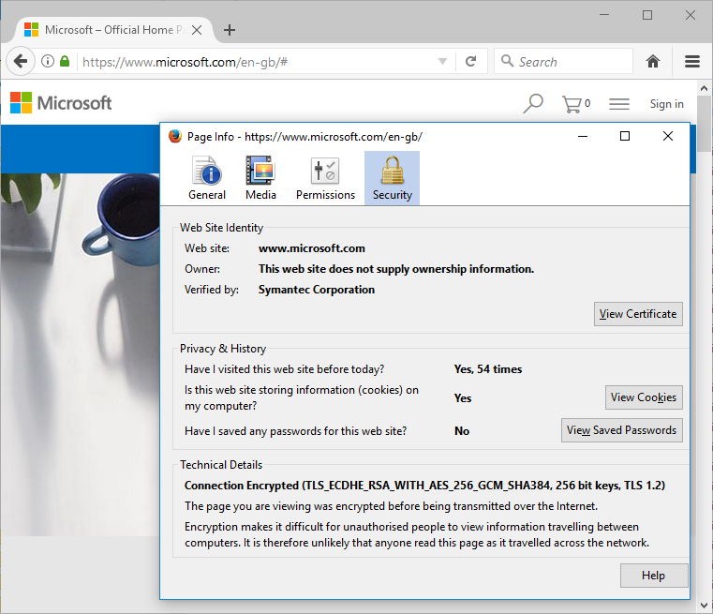
Web Server Certificate Types
Domain Validation (DV)
More rigorous identity checks
Extended Validation (EV)
Even more rigorous identity checks
Screenshot used with permission from Microsoft.
Notes:
Make sure students can distinguish DV and EV and understand the use of SAN or wildcard certificates.

Slide 48
3.9 Given a scenario, implement public key infrastructure
Types of certificates
Wildcard certificate (Key: ONE main domain only!)
Deploy PKI on its Internet-facing website (public facing)
Used on multiple servers in the same domain
Used for the domain and a multiple subdomains
www.google.com
sheets.google.com
scholar.google.com
Same domain
Multiple Subdomain prefixes

Slide 49
3.9 Given a scenario, implement public key infrastructure
Types of certificates
Subject Alternative Name (SAN) Certificate (Key: MULTIPLE main domains owned by one organization only!)
X.509 certificate used on multiple domain names
install the same X.509 certificate on multiple servers
Provides extended validation
Provide a higher level of trust in identifying the entity that is using the certificate
www.google.com www.youtube.com sheets.google.com scholar.google.com
Different Domain names
Sub-domain prefixes
Notes:
YouTube domains: https://www.netify.ai/resources/applications/youtube

Slide 50
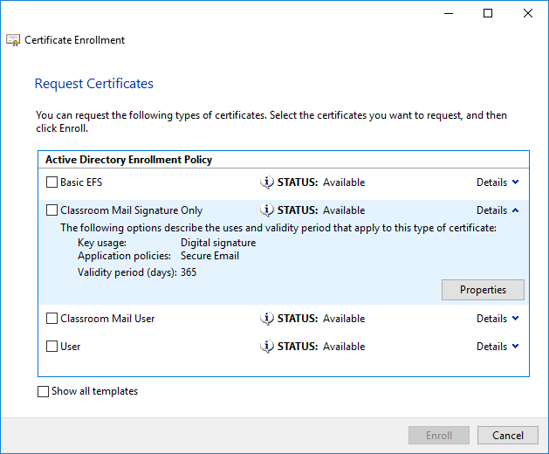
Other Certificate Types
Screenshot used with permission from Microsoft.
Machine/computer
Servers and network appliances
Identify by FQDN
Email/user certificate
Can be various types (email, encryption, smart card logon, and so on)
Identify by email address
Code signing
Validate publisher name
Root certificate
Self-signed certificate for the CA
Self-signed certificate
Must be manually trusted
Self-signed certificate is issued by the same entity that is using it
Does not have a CRL and cannot be validated or trusted
A self-signed certificate can be installed on internal facing websites as a cheaper option

Slide 51
Certificate Formats and encoding
Certificate
.CER/.CRT – ASCII Base64 or Binary – Certificate file – Can be PEM or DER encoded
Encoding
Privacy Enhanced Mail (.PEM) – ASCII Base64 – Most widely used
Distinguished Encoding Rules (.DER) – Binary – Common with Java
Key Files | Format | File Extension
Private | P12 | .pfx .p12
Public | P7B | .p7b .p7c
.PEM = Privacy Enhanced Mail
.DER = Distinguished Encoding Rules
.PFX = Personal Information Exchange

Slide 52
Cryptographic Attacks
Man-in-the-Middle (MitM)
Interferes with the public key presented to the client
Downgrade attack
Forces server into using weak protocol versions and ciphers
Collisions and the Birthday Attack
Exploit collisions to forge a signature
Hashed passwords and digital signatures are susceptible to birthday attacks
MD5HASH document.doc 049eab40fd36caadlfab10b3cdf4a883
MD5HASH image.jpg 049eab40fd36caadlfab10b3cdf4a883
Rainbow tables
Pre-computed lists of passwords with the relevant hash in either MD5 or SHA-1
Tables speed up the cracking of passwords that have been hashed
(SSL 3.0 /TLSv1.0 + CBC = MITM)

Slide 53
Answer the Questions…
A company wants to deploy PKI on its Internet-facing website. The applications that are currently deployed are:
www.company.com(main website)
contactus.company.com(for locating a nearby location)
quotes.company.com (for requesting a price quote)
The company wants to purchase one SSL certificate that will work for all the existing applications and any future applications that follow the same naming conventions, such as store.company.com. Which of the following certificate types would BEST meet the requirements?
SAN
Wildcard
Extended validation
Self-signed
A security analyst needs to generate a server certificate to be used for 802.1X and secure RDP connections. The analyst is unsure what is required to perform the task and solicits help from a senior colleague. Which of the following is the FIRST step the senior colleague will most likely tell the analyst to perform to accomplish this task?
Create an OCSP
Create a CSR
Create a CRL
Create a .pfx file
Notes:
Answers
b (wildcard)
b (CSR- certificate signing request)

Slide 54
QUESTIONS

Slide 55
Syllabus Objectives Covered
2.8 Summarize the basics of cryptographic concepts
1.2 Given a scenario, analyze potential indicators to determine the type of attack
3.9 Given a scenario, implement public key infrastructure

